Slide 1
Web development
Student: Nicole Jade D. Fernandez
4100E211 潔妮可
Teacher: My dear great teacher

Slide 2
agenda
Web programming
Web server and database
HTML programming
CSS
Server side programming (PHP)
JAVAscript
My funny web site

Slide 3
Web Programming https://en.wikipedia.org/wiki/Web_development
Web development is the work involved in developing a website for the Internet or an intranet. Web development can range from developing a simple single static page of plain text to complex web applications, electronic businesses, and social network services.

Slide 4

Web Server Database
A database server is any server that runs a network database application and maintains database files, such as Microsoft SQL Server or Oracle. SQL Server is a high-performance database management system.
Example: XAMPP

Slide 5

XAMPP
Xampp is a stack server which contains Apache HTTP Server, Maria DB database, and interpreters for scripts written in the PHP and Perl programming languages.

Slide 6
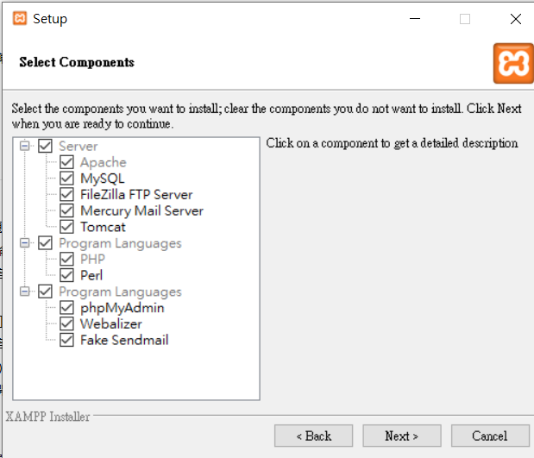
PROGRAM LANGUAGES is a language in technology which use different kind of codes for outputs in programming or Technology.

Slide 7
https://en.wikipedia.org/wiki/Webalizer

Slide 8
phpMyAdmin is a free software tool written in PHP
A web interface for MySQL and MariaDB.
https://docs.phpmyadmin.net/,

Slide 9
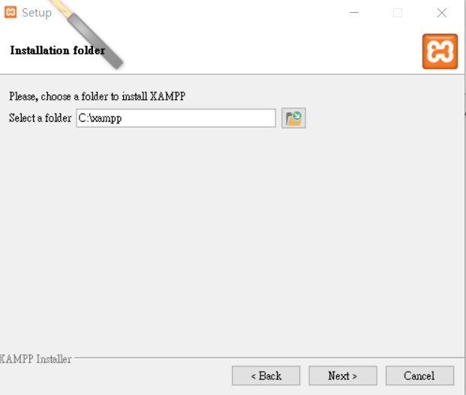

Slide 10
XAMPP HTML PROGRAMMING (my works)

Slide 11
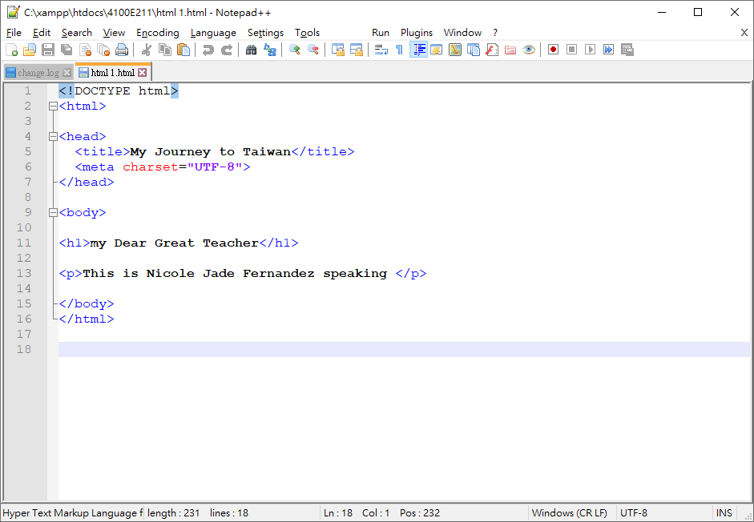
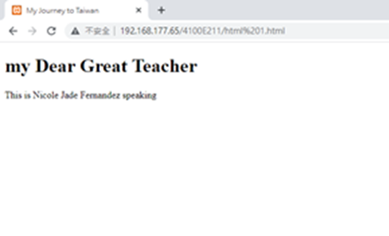
XAMPP HTML PROGRAMMING
HTML 1.html
Headings
HTML codes
RESULT

Slide 12
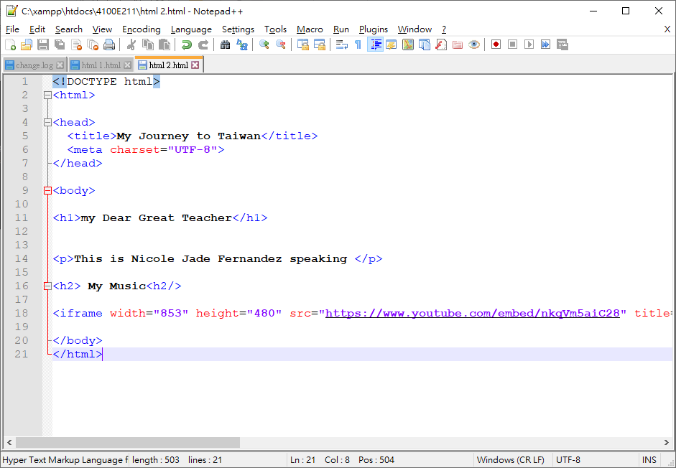
XAMPP HTML PROGRAMMING
Html 2.html
HTML codes

Slide 13
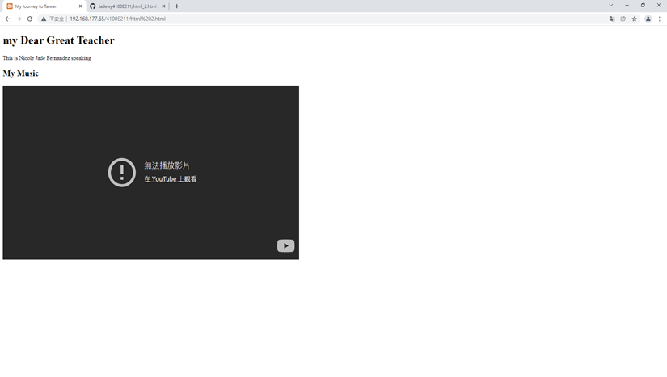
Result

Slide 14
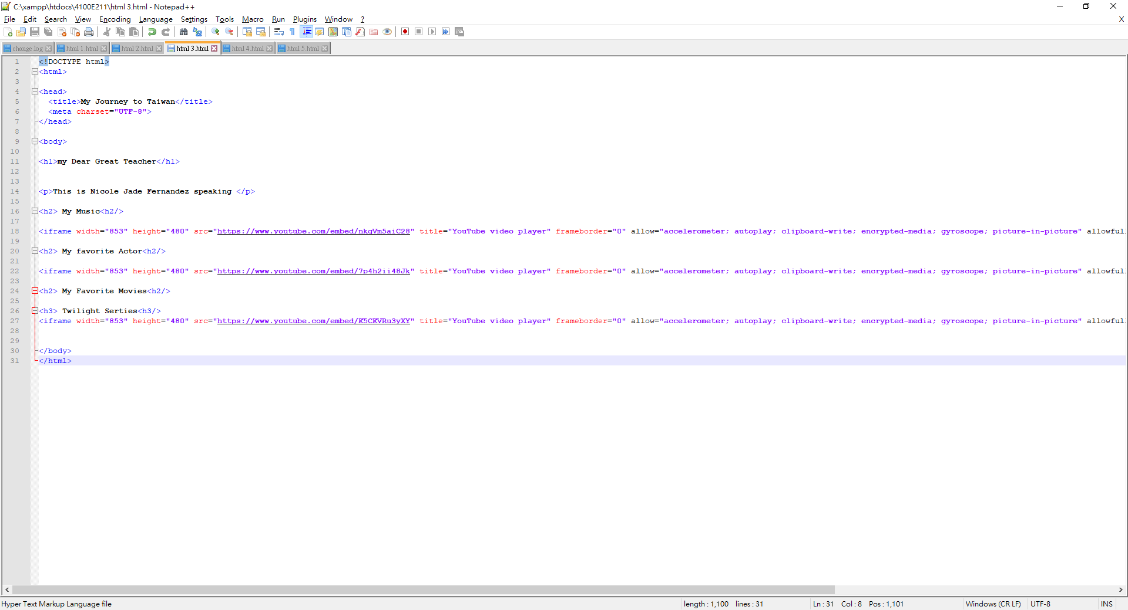
XAMPP HTML PROGRAMMING
Html 3.html
HTML codes

Slide 15
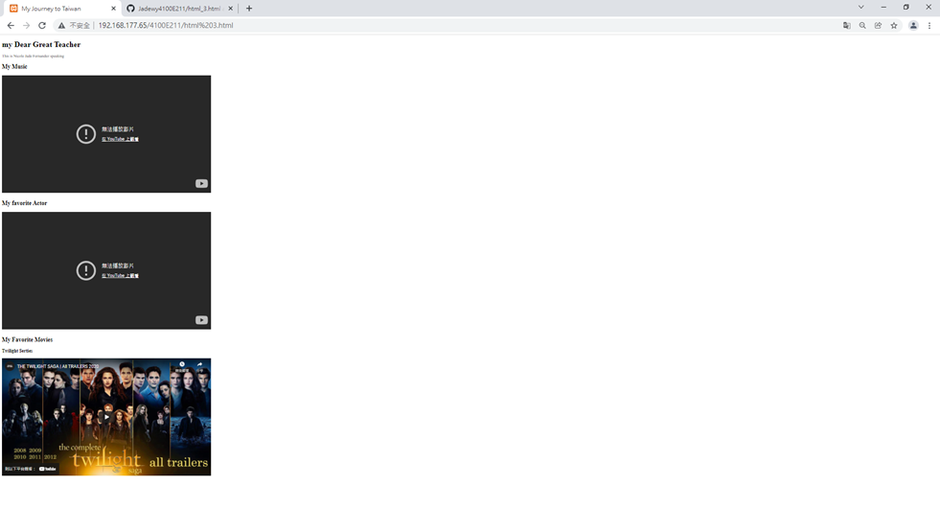
Result

Slide 16
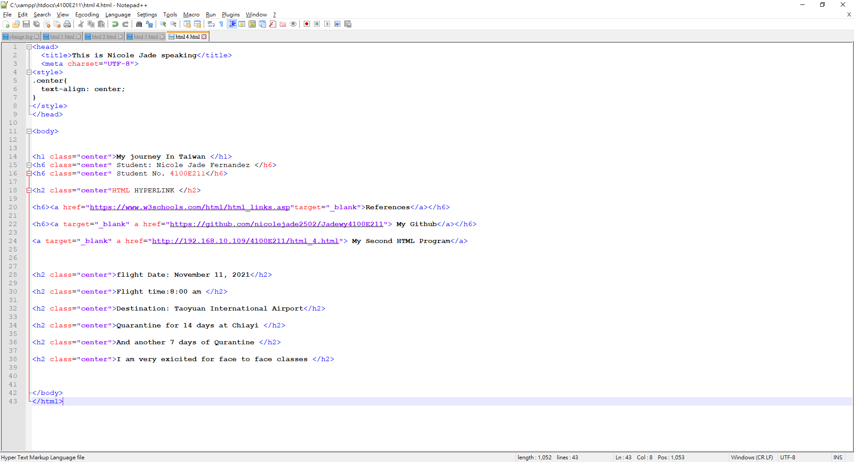
XAMPP HTML PROGRAMMING
Html 4.html
HTML codes

Slide 17
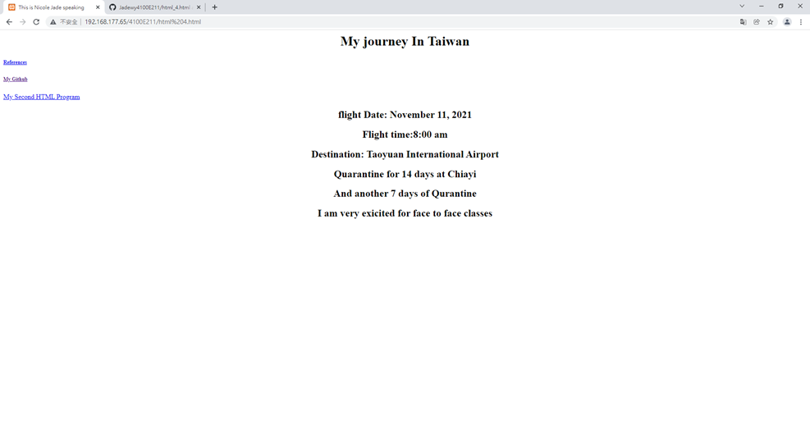
Result

Slide 18
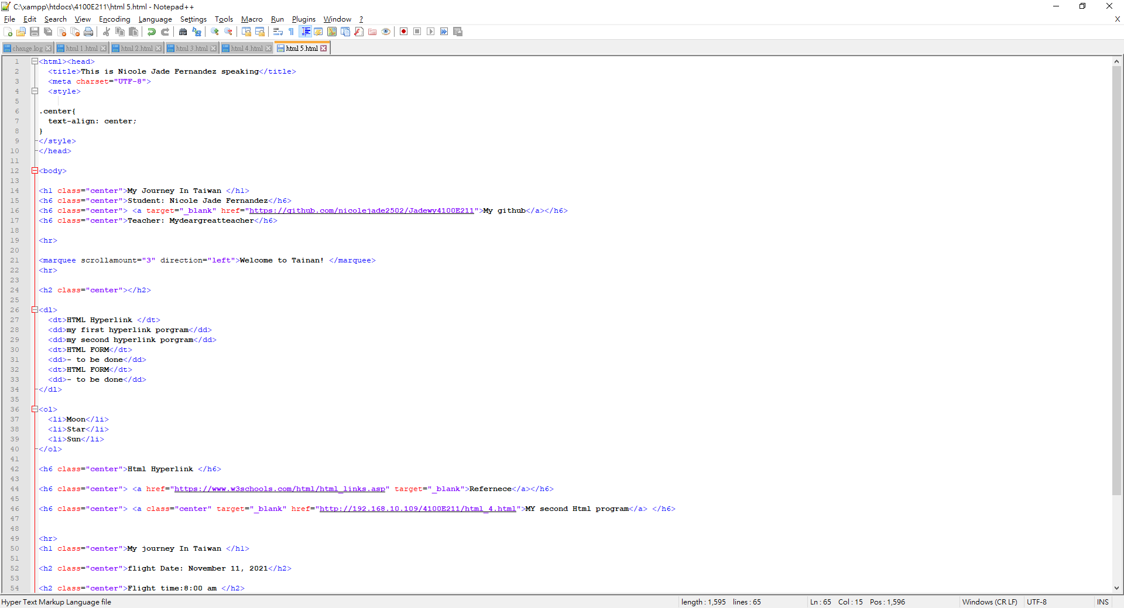
XAMPP HTML PROGRAMMING
HTML 5.html
HTML codes

Slide 19
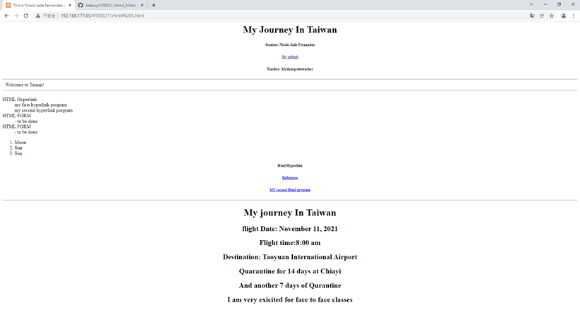
Result

Slide 20
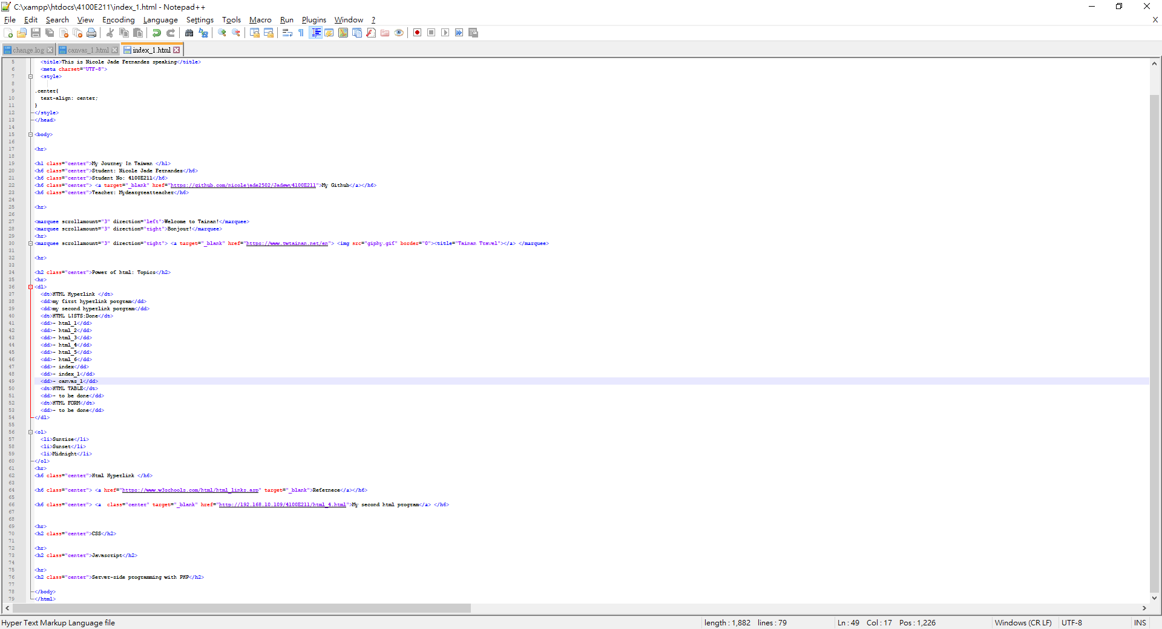
XAMPP HTML PROGRAMMING
Index_1.html

Slide 21
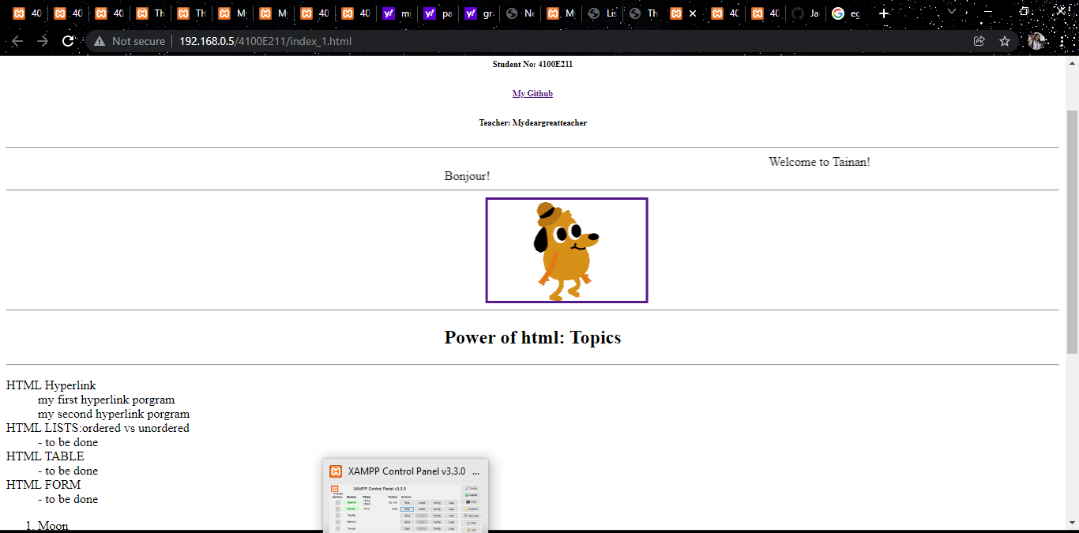
Result

Slide 22
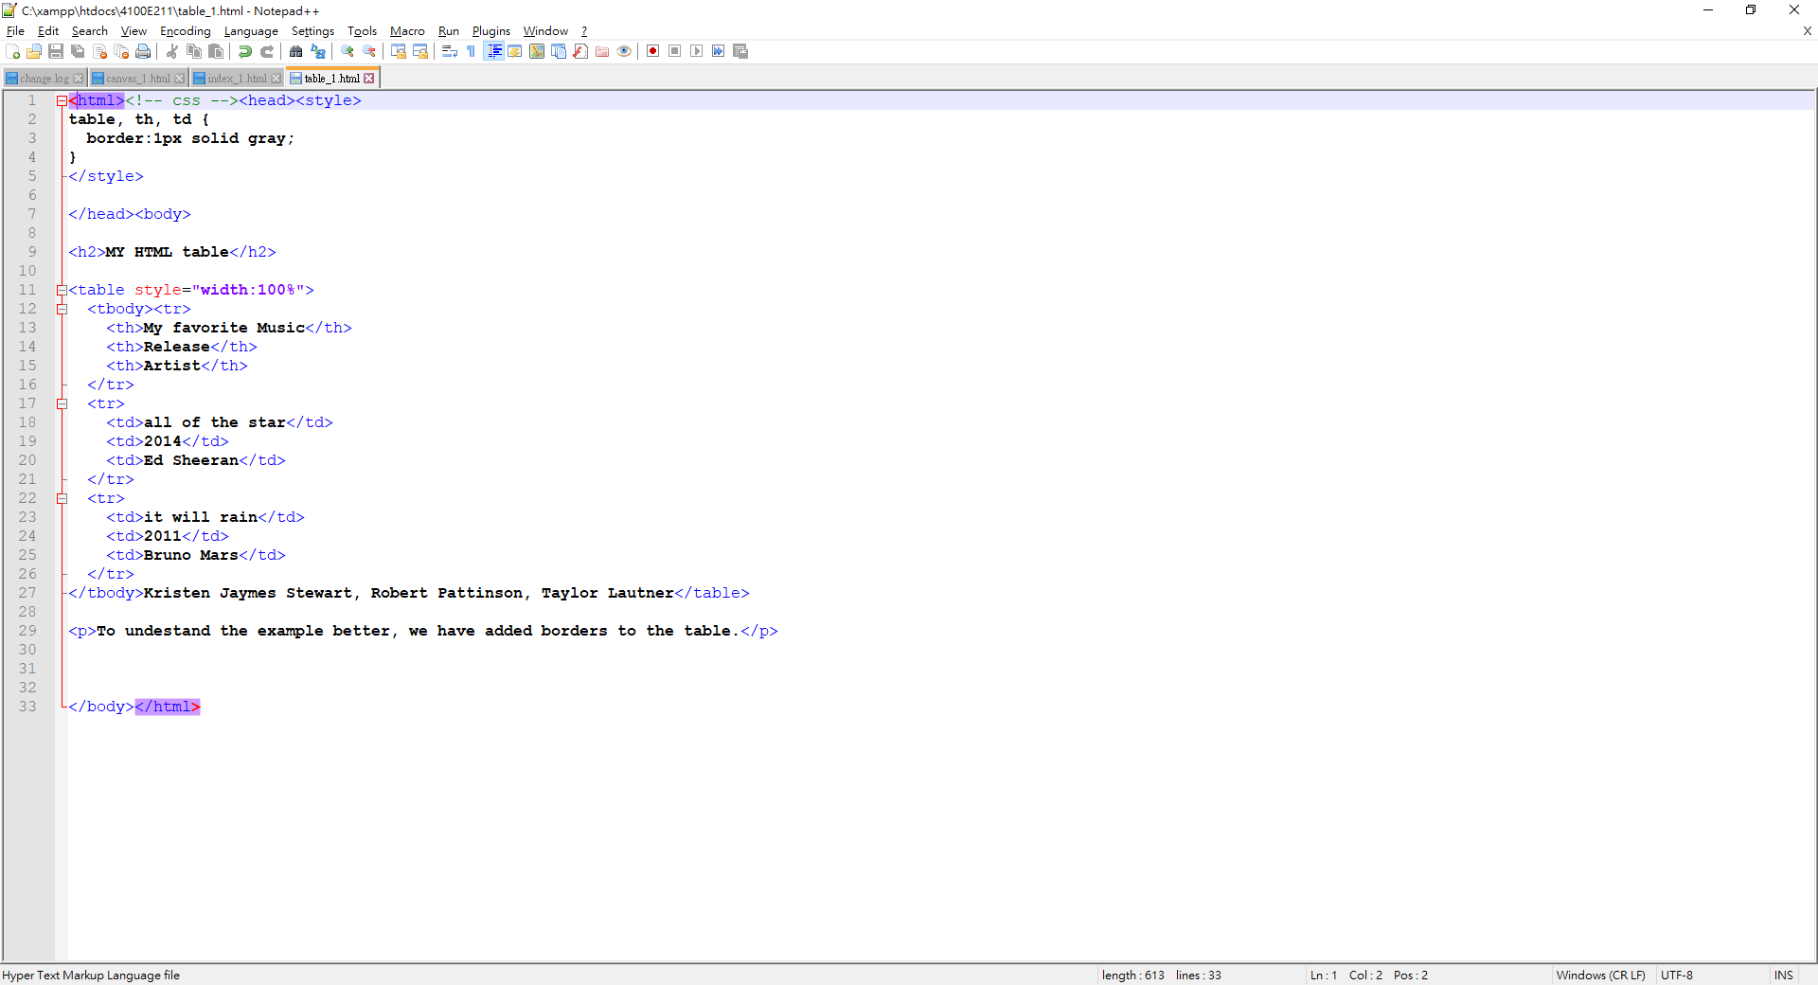
XAMPP HTML PROGRAMMING
Table_1.html
HTML codes

Slide 23
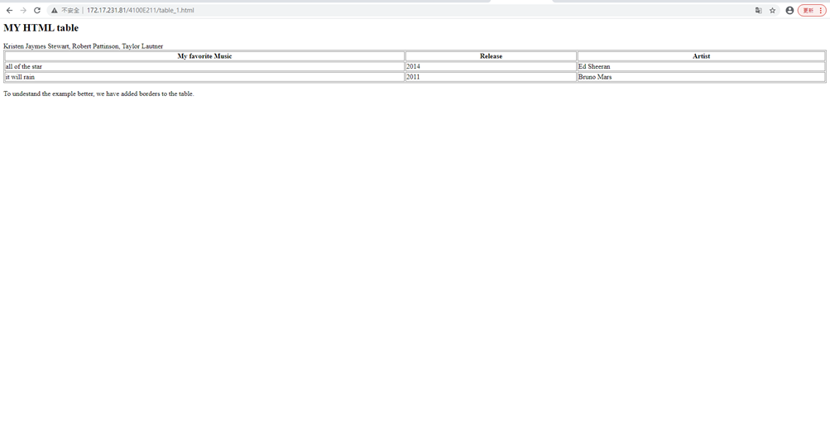
Result

Slide 24
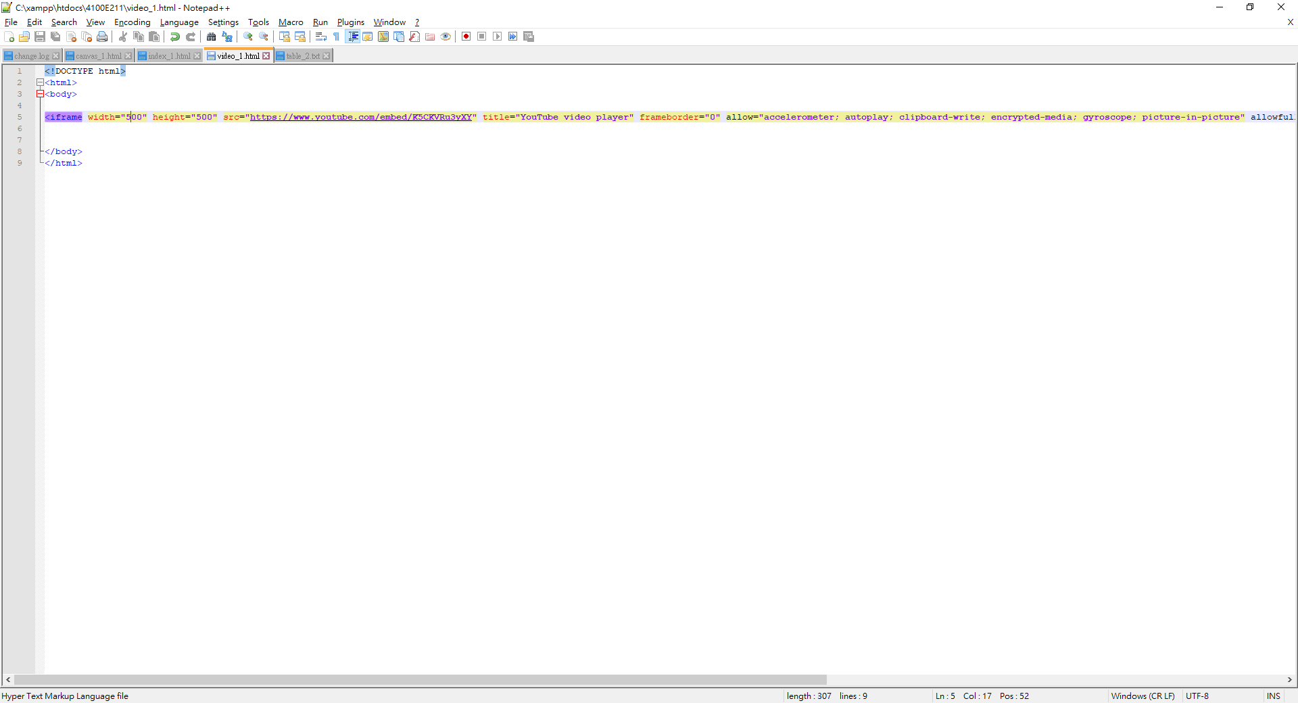
XAMPP HTML PROGRAMMING
Video_1.html
HTML codes

Slide 25
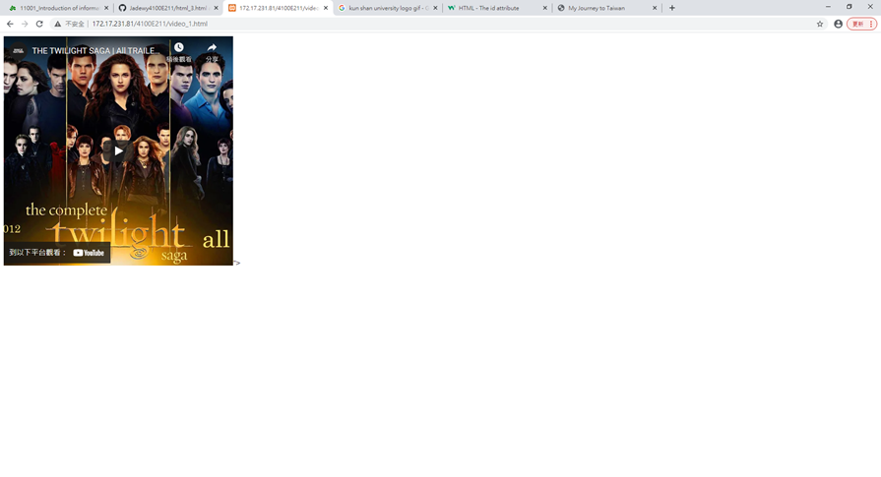
Result

Slide 26
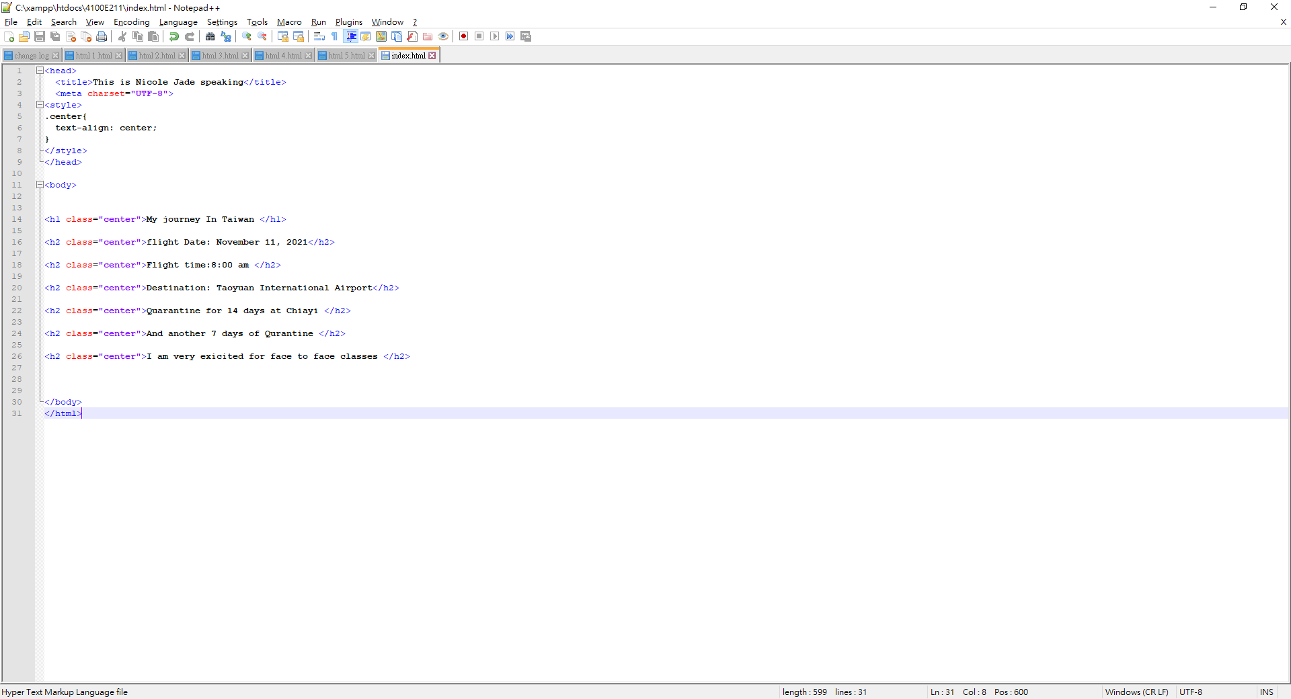
XAMPP HTML PROGRAMMING
Index.Html
HTML codes

Slide 27
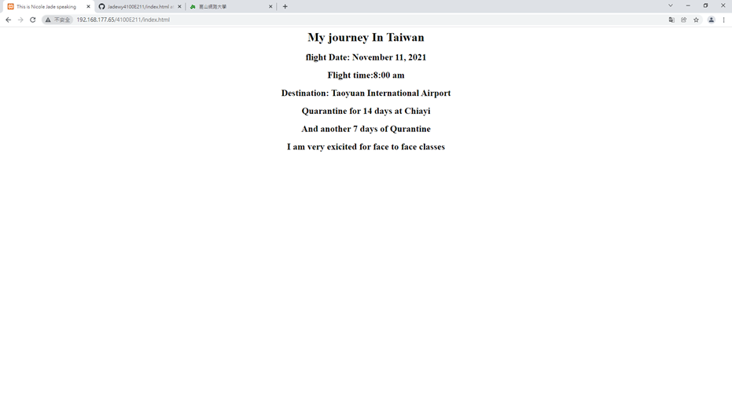
Result

Slide 28
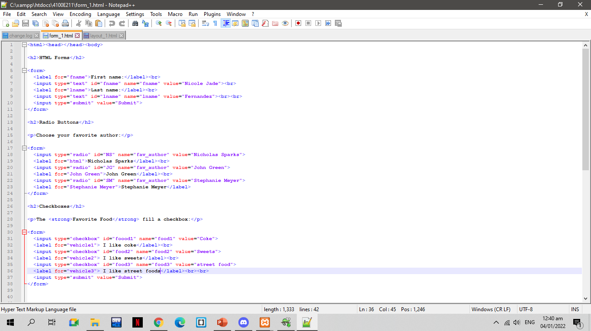
XAMPP HTML PROGRAMMING
Form 1.html
HTML codes

Slide 29
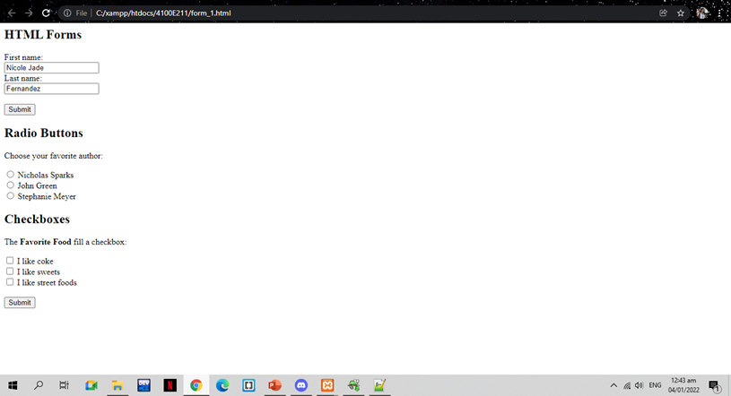
Result

Slide 30
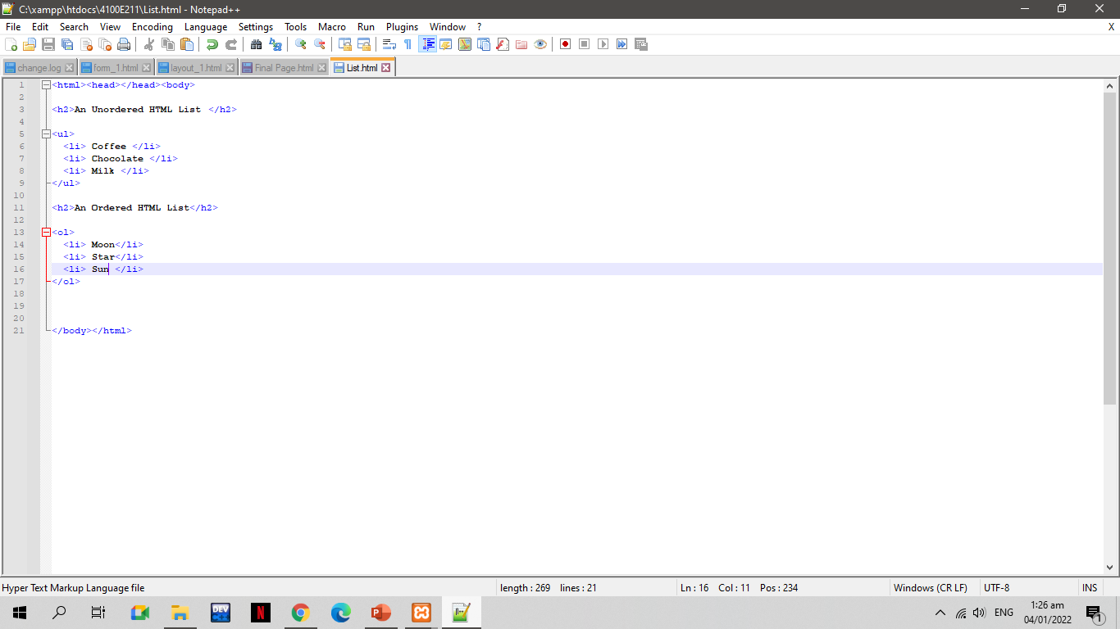
XAMPP HTML PROGRAMMING
Order List. Html

Slide 31
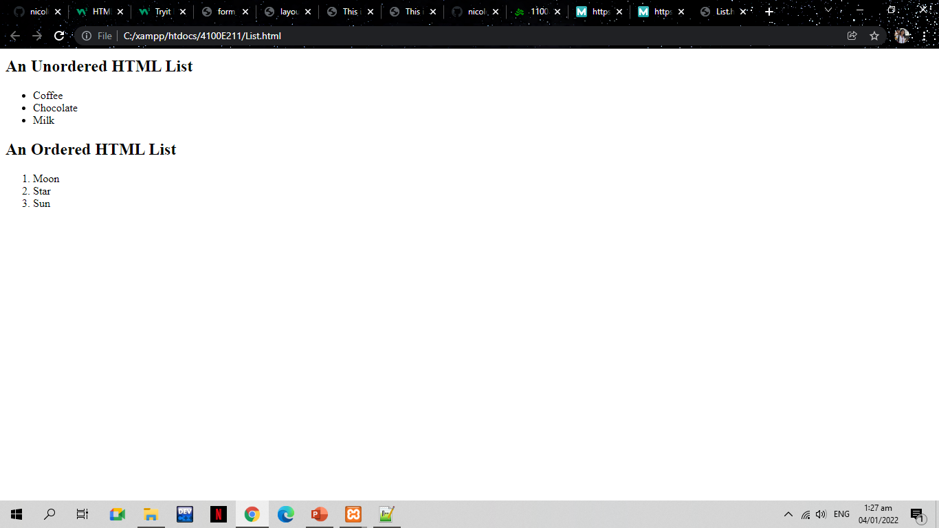
Result

Slide 32

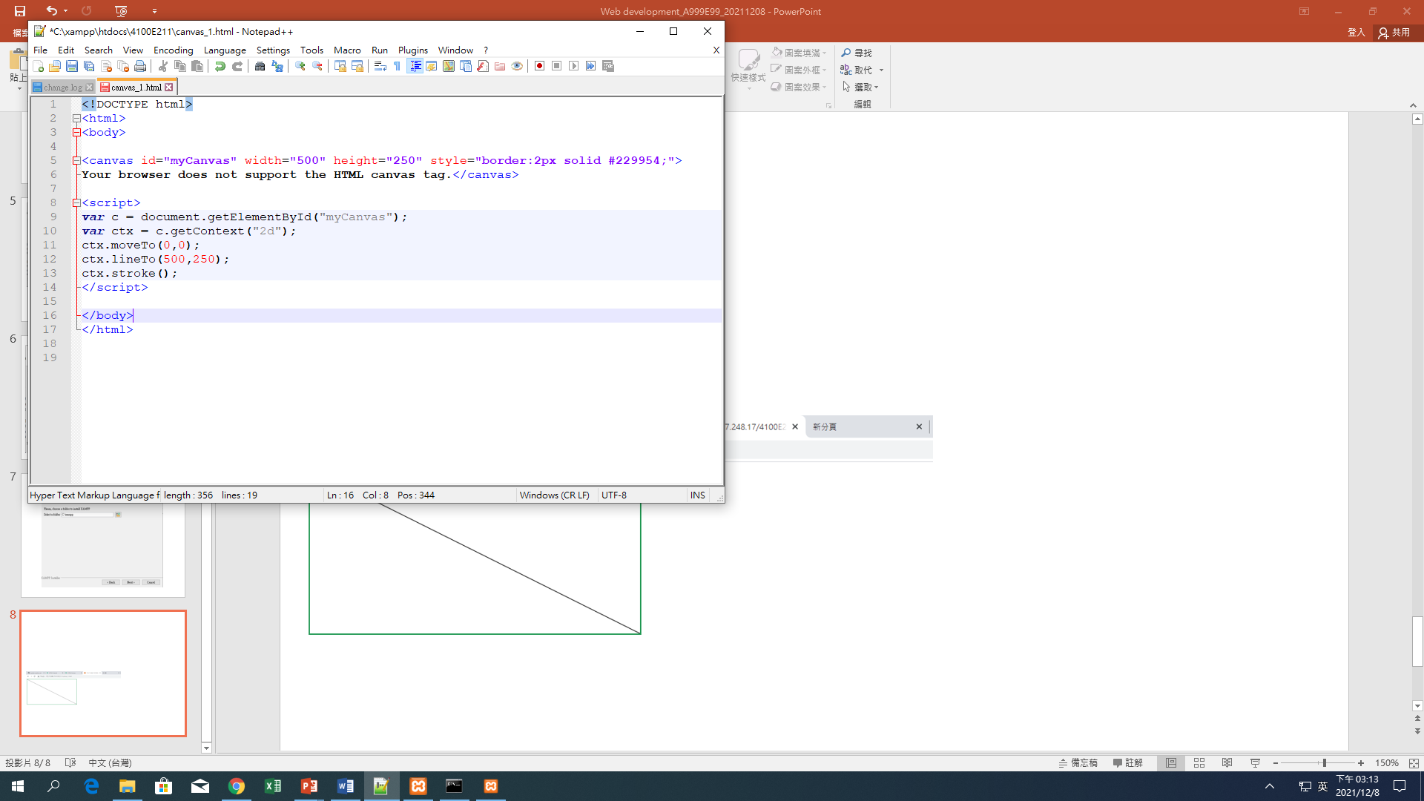
XAMPP HTML PROGRAMMING
(CANVAS - LINE)

Slide 33
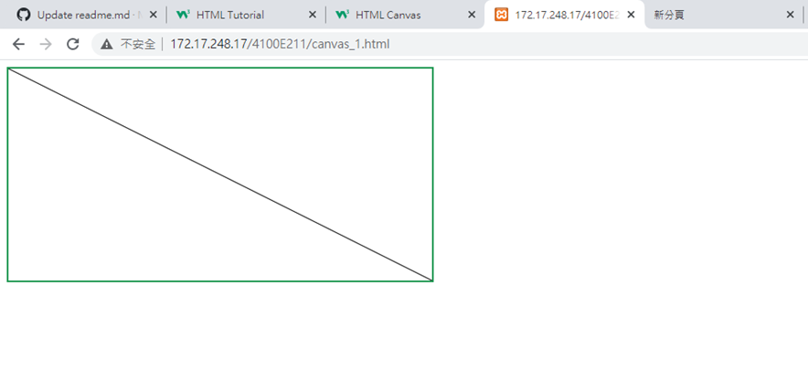
Result

Slide 34
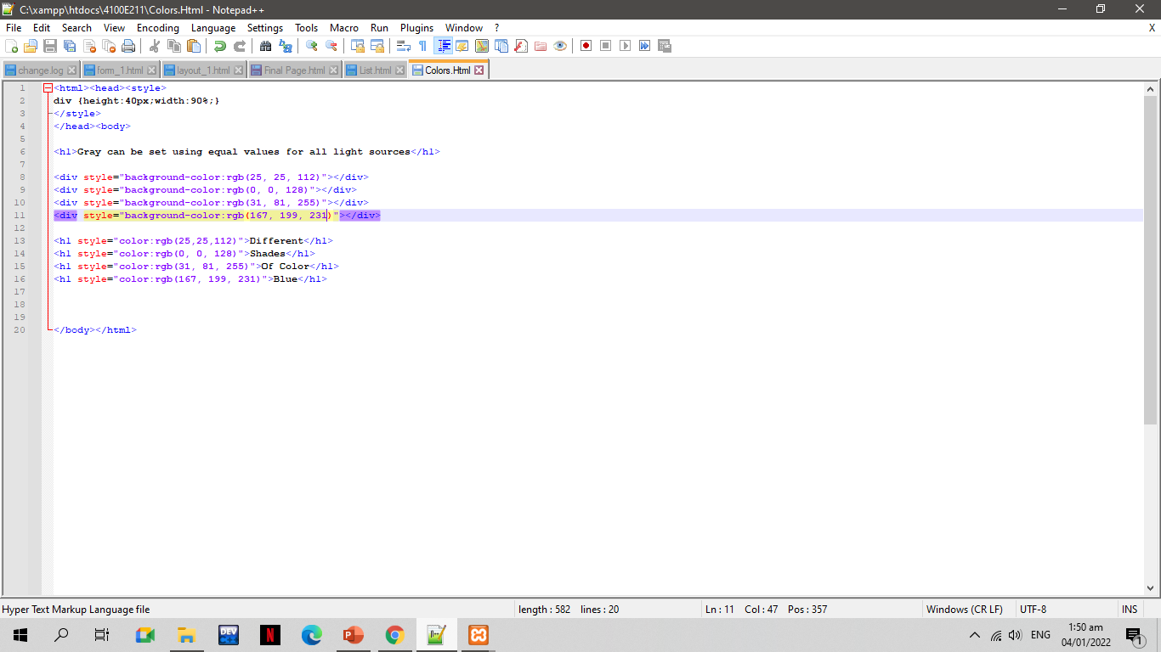
XAMPP HTML PROGRAMMING
Colors. Html

Slide 35
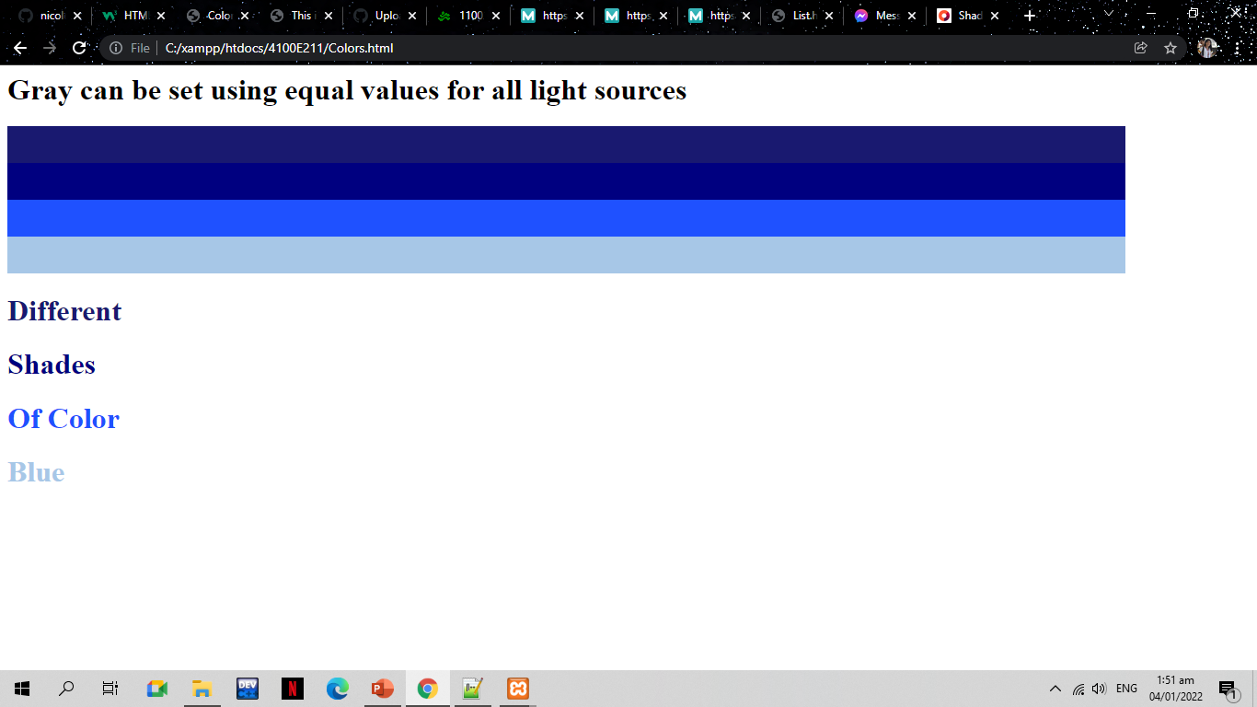
Result

Slide 36
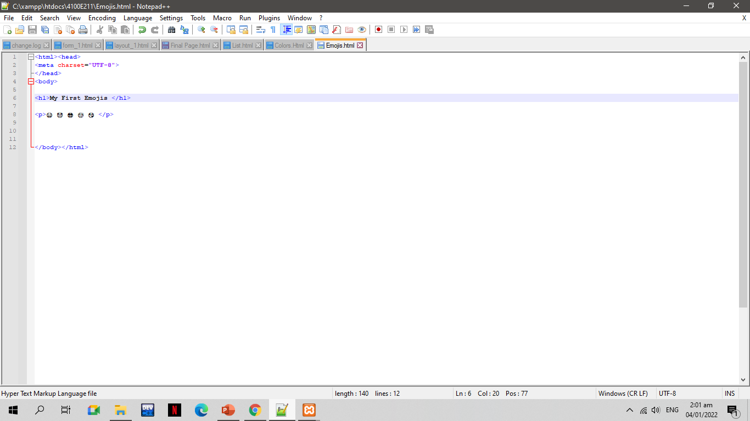
XAMPP HTML PROGRAMMING
Emojis.Html

Slide 37
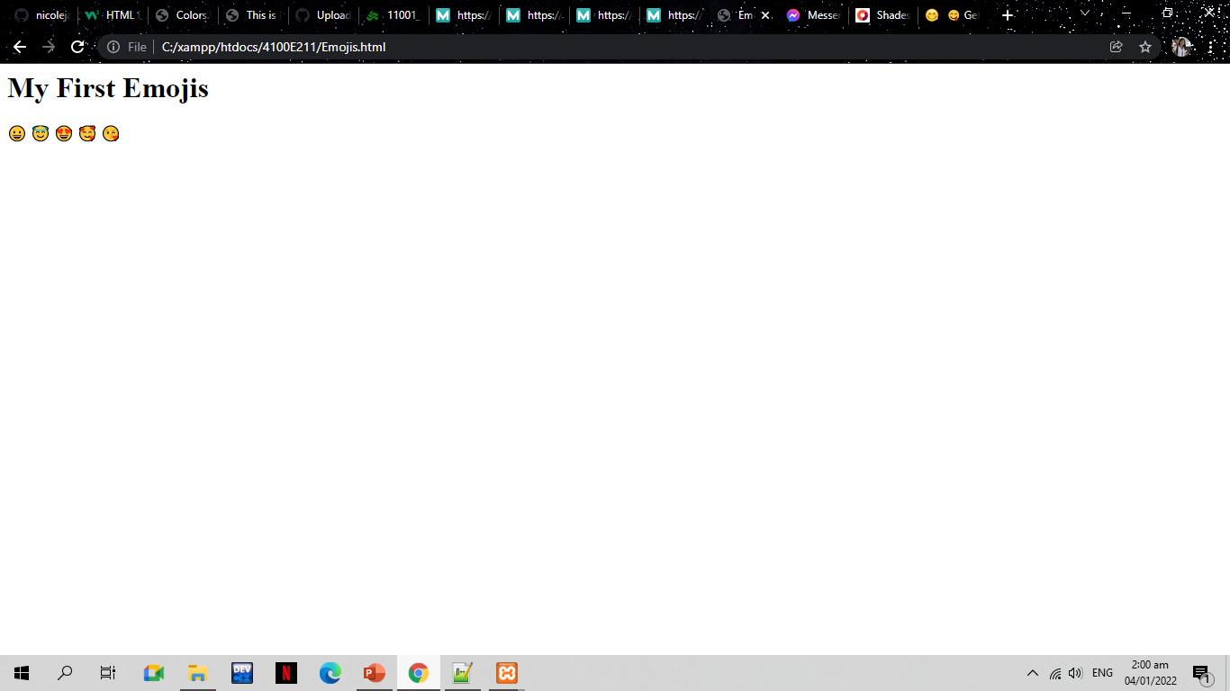
Result

Slide 38
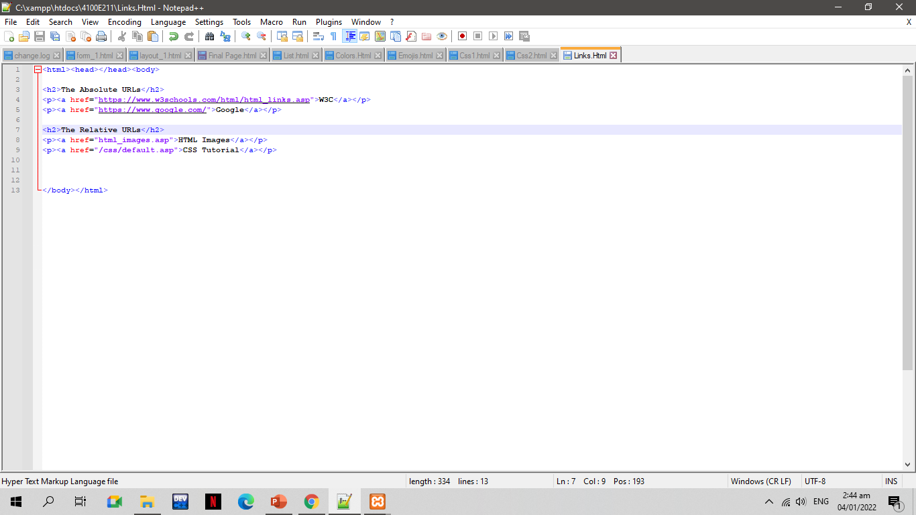
XAMPP HTML PROGRAMMING
Links.Html

Slide 39
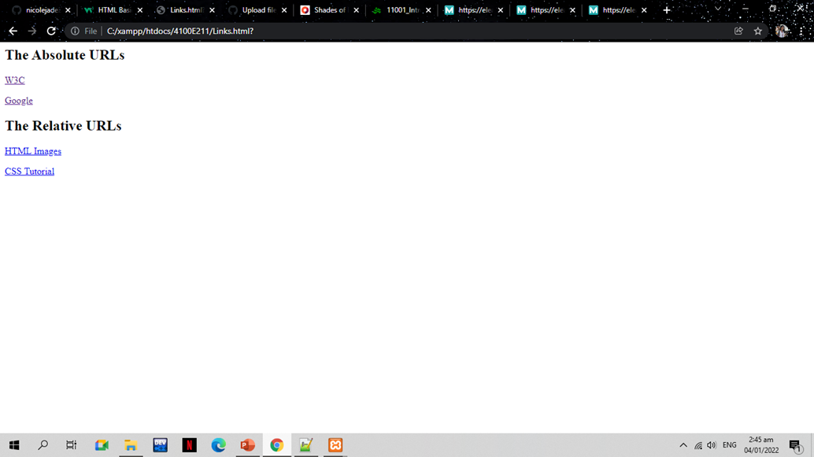
RESULT

Slide 40
CSS Programming

Slide 41
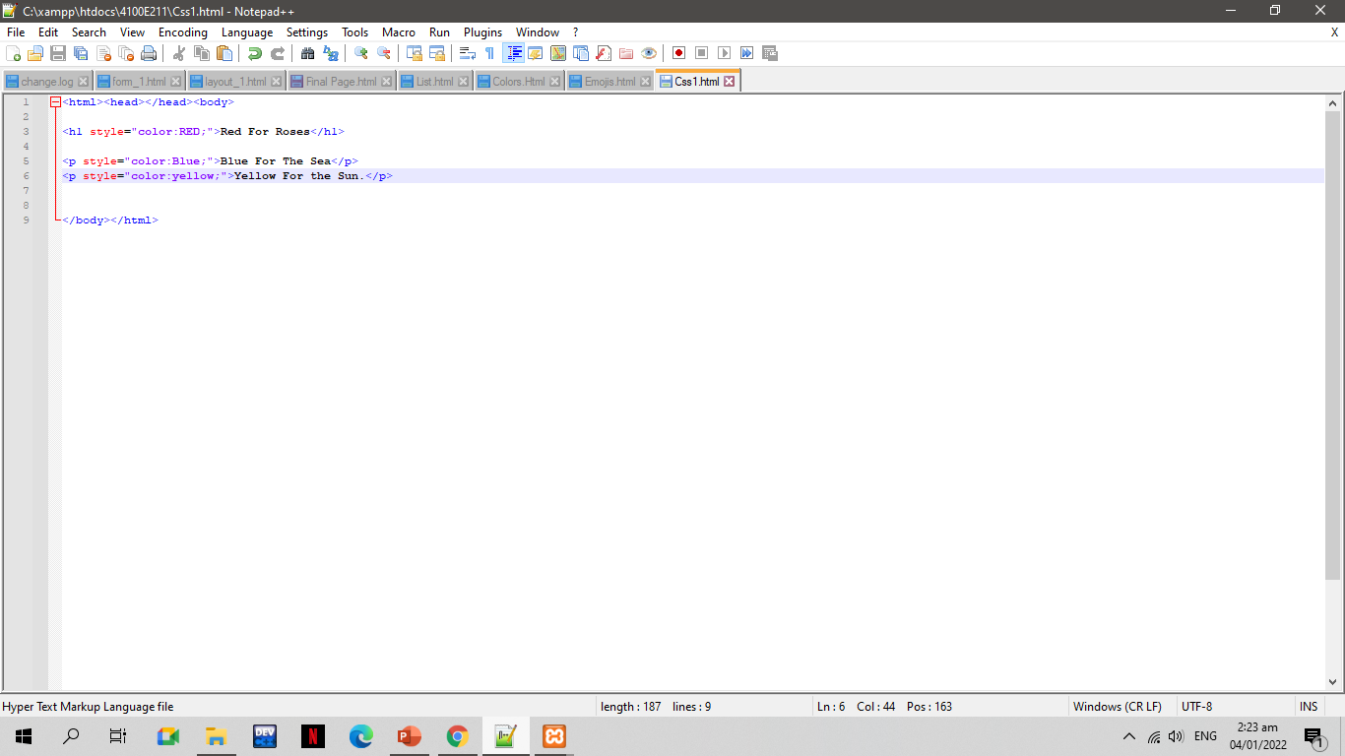
XAMPP CSS PROGRAMMING
Css1.html

Slide 42
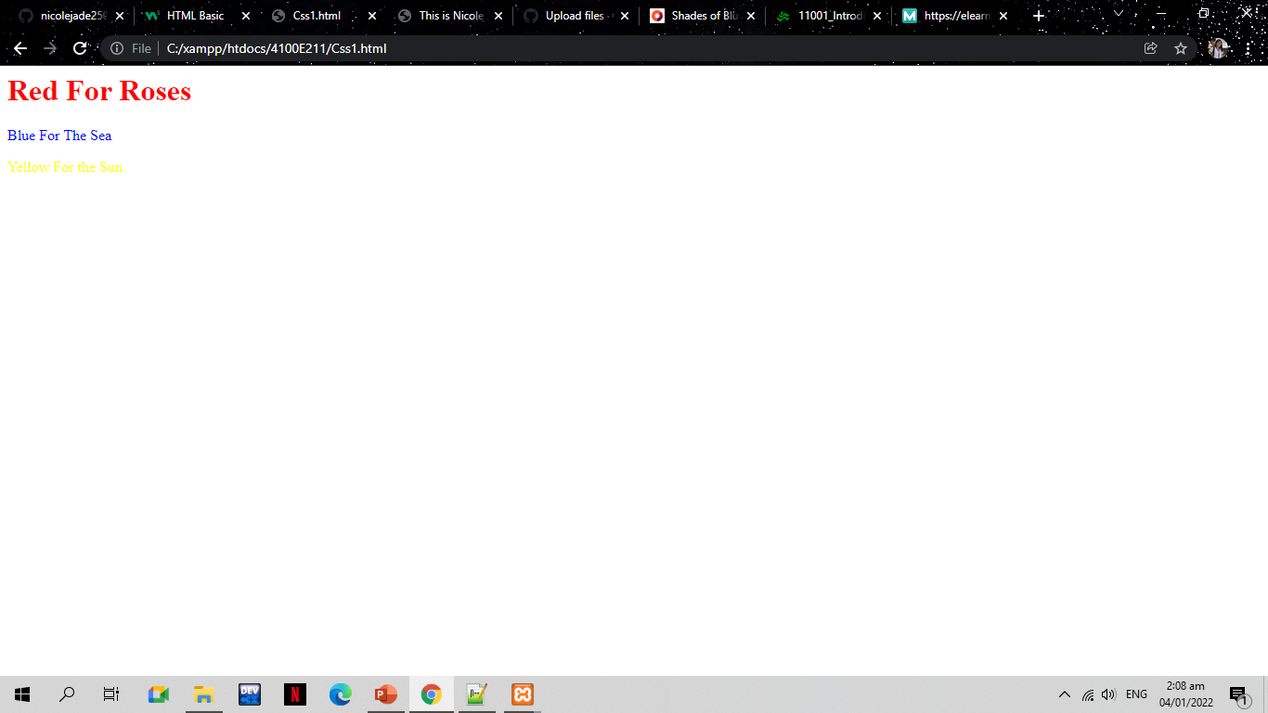
Result

Slide 43
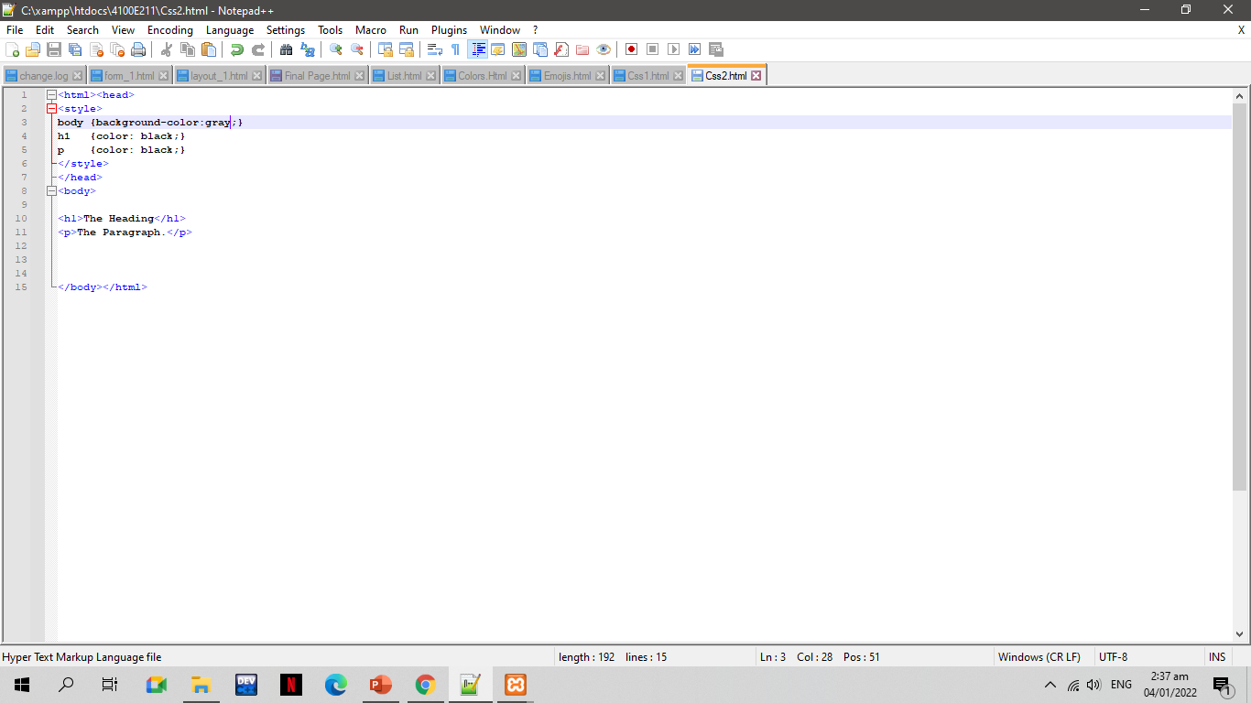
XAMPP CSS PROGRAMMING
CSS2.HTML

Slide 44
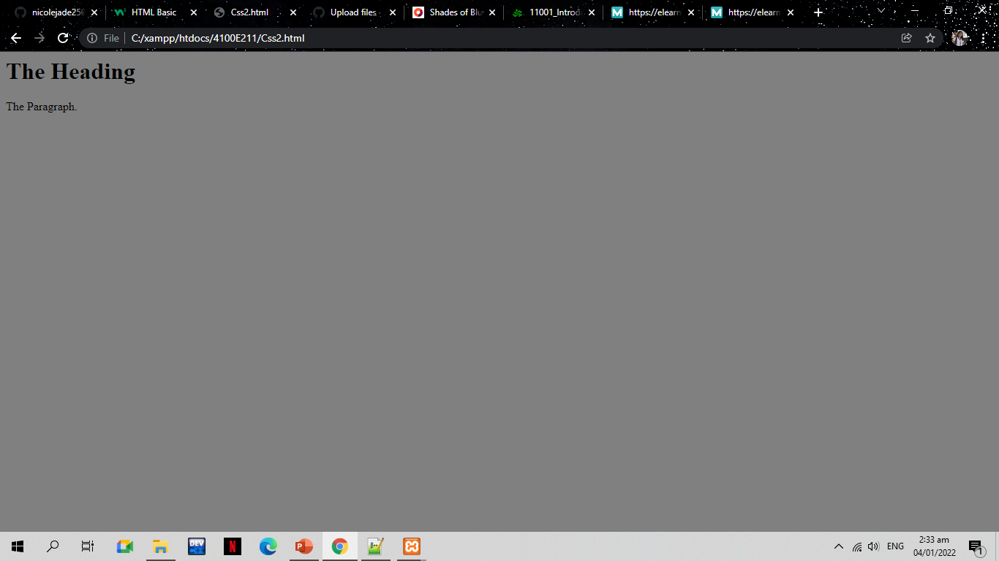
Result

Slide 45
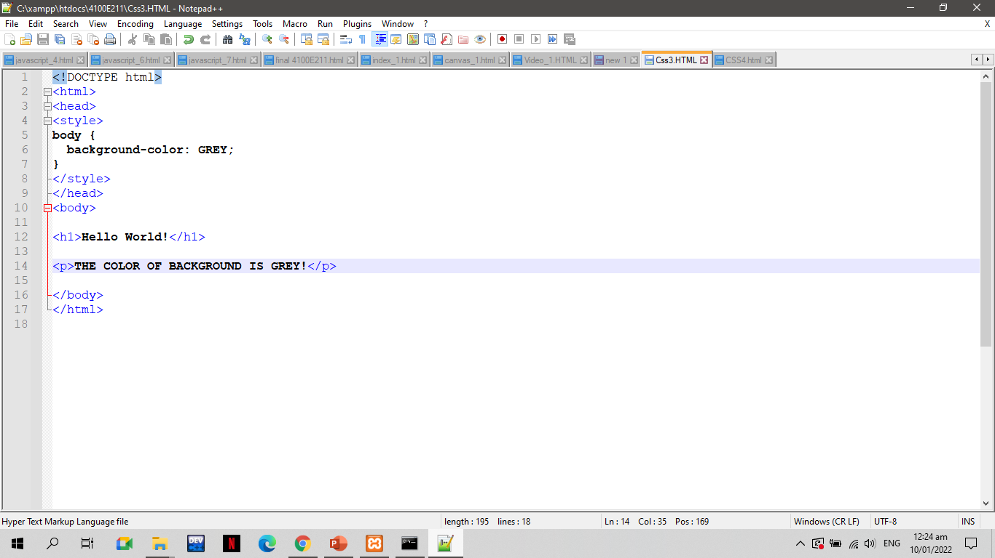
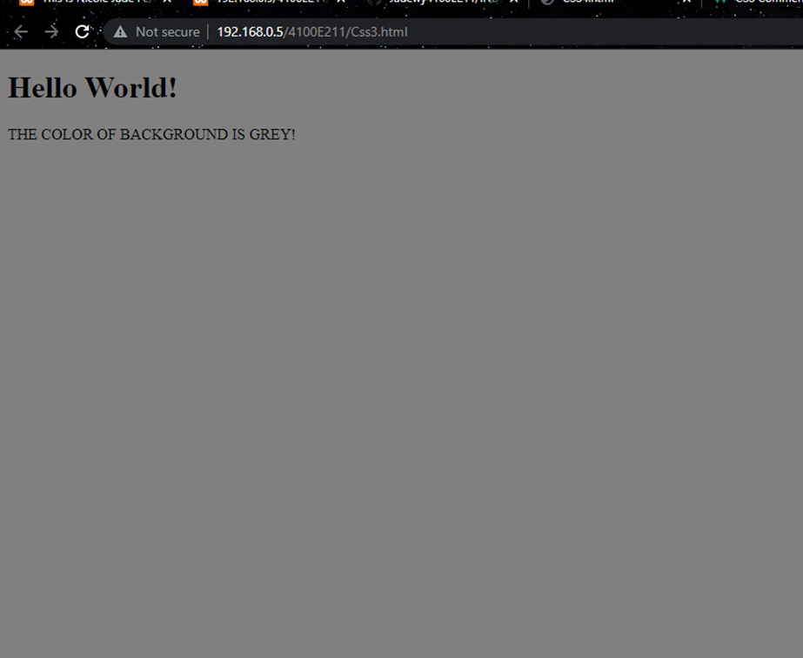
CODES
CSS3.HTML
RESULT

Slide 46
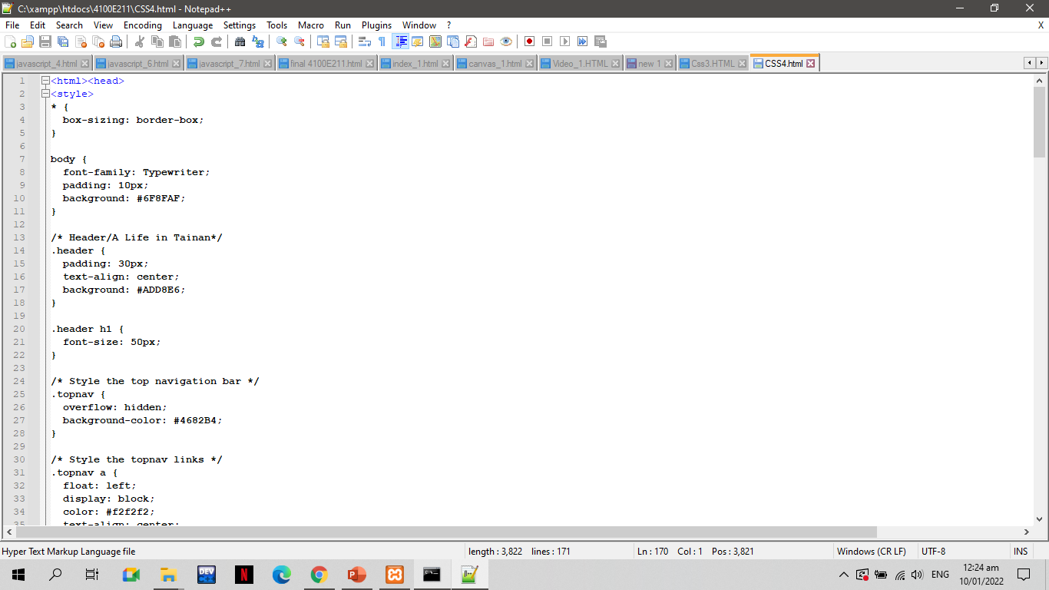
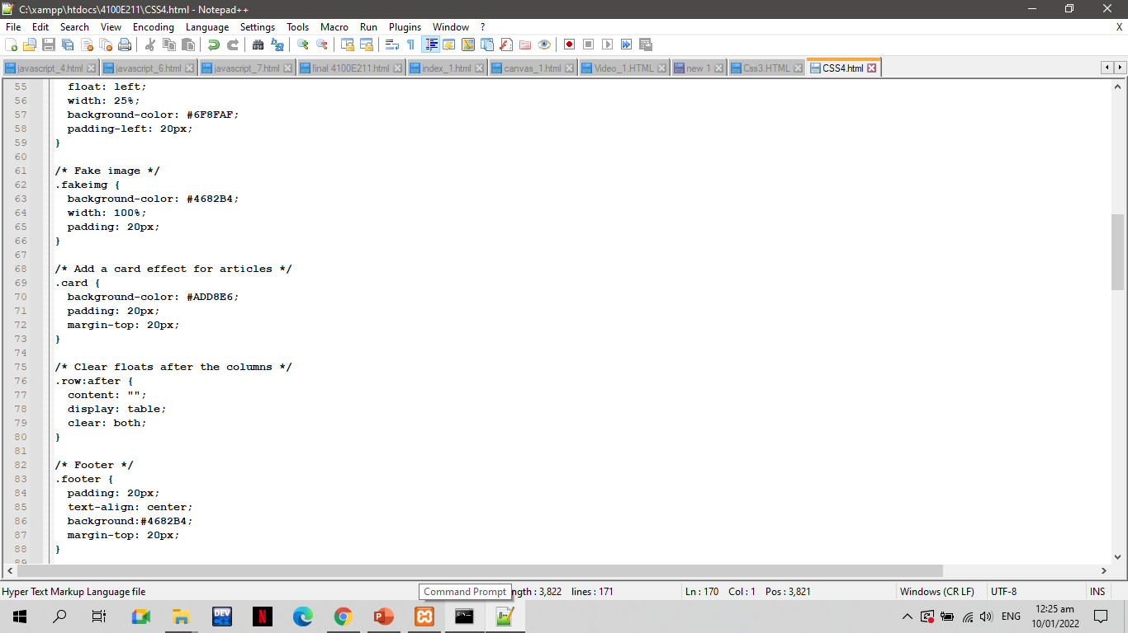
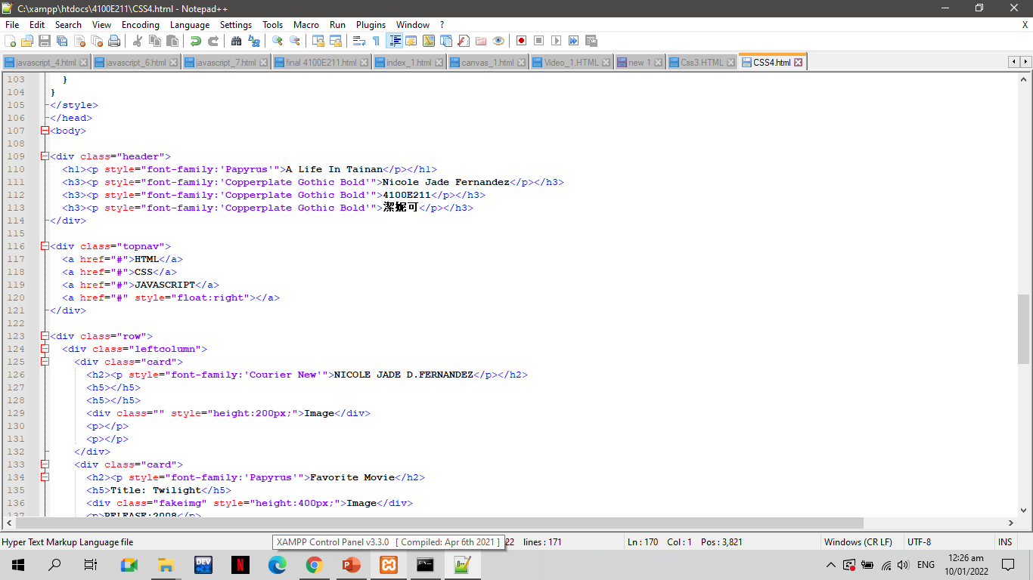
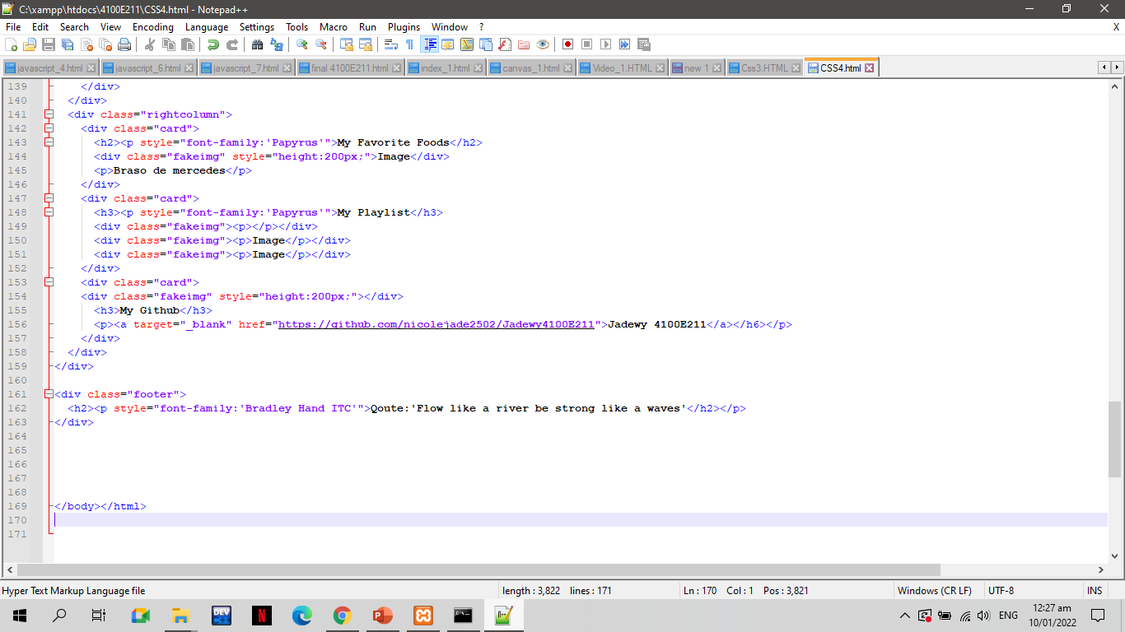
CODES
CSS4.HTML

Slide 47
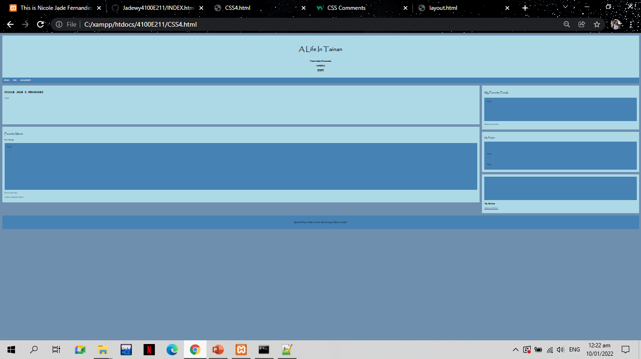
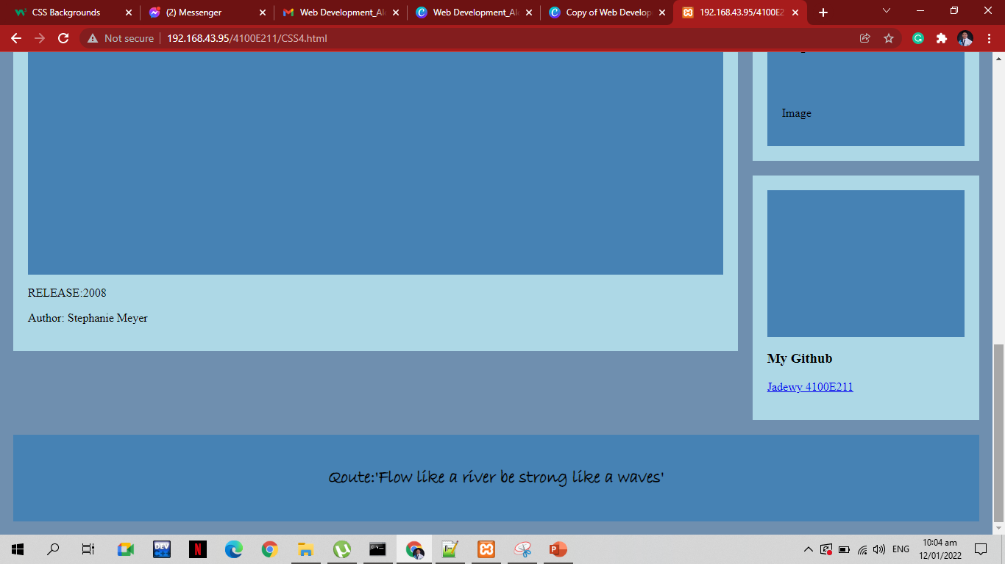
RESULT

Slide 48
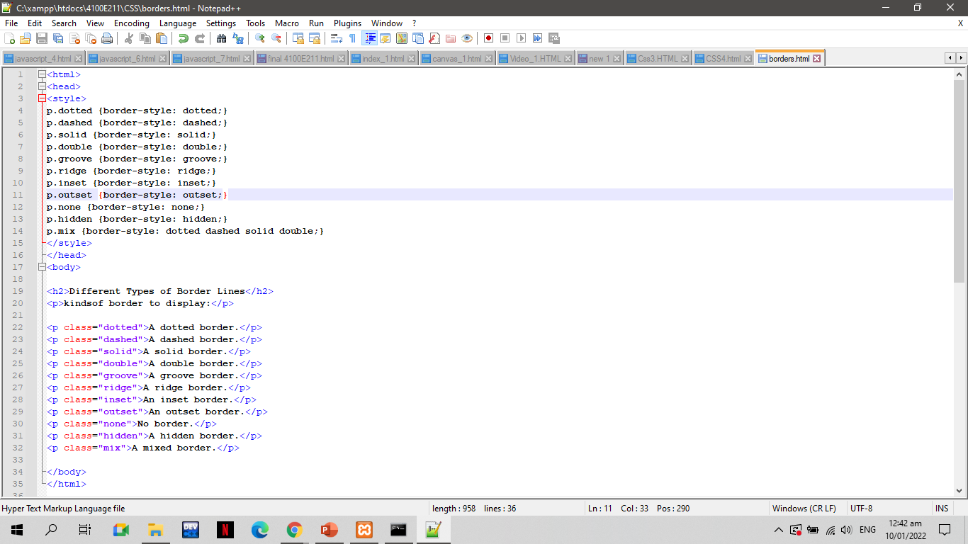
CSS CODES
BORDERS.HTML

Slide 49
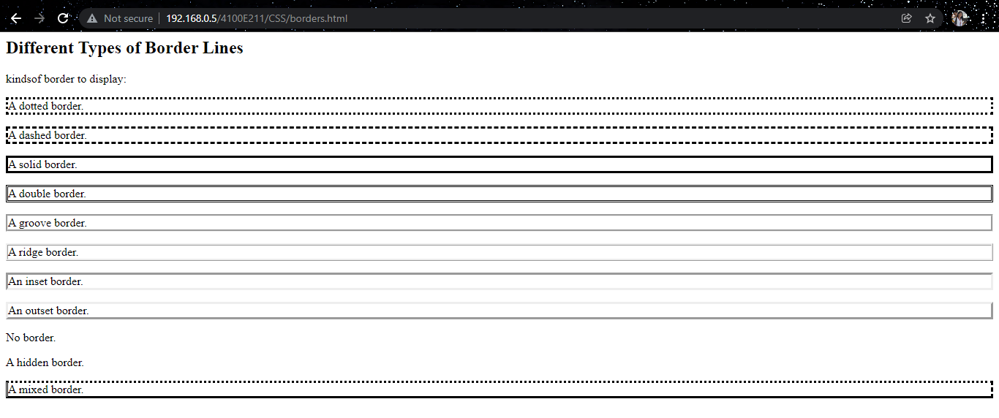
RESULT

Slide 50
Server-side programming

Slide 51
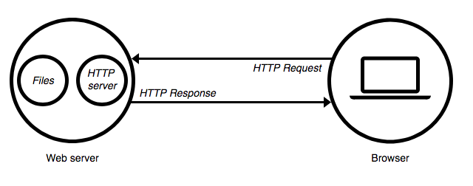
SERVER –SIDE PROGRAMMING https://medium.com/@BaaniLeen/web-development-series-intro-to-server-side-scripting-fe5626323f92
The server side programming is the name given to all types of programs which run on the web server. They process the user input, interact with the databases and control what content is served back to the client as a response to his request
Server-side processing happens when a page is first requested and when pages are posted back to the server. Examples of server-side processing are user validation, saving and retrieving data, and navigating to other pages.
It is written in a number of programming languages including PHP, NodeJS, Python, etc and has full access to the server’s OS and the programmer can chose the language he/she wants to code in.
Server-side programming is extremely useful as it helps to efficiently deliver user-customised content, and thus enhance the user experience. It can also be used to refine responses based on the user’s data (Data Analysis).

Slide 52
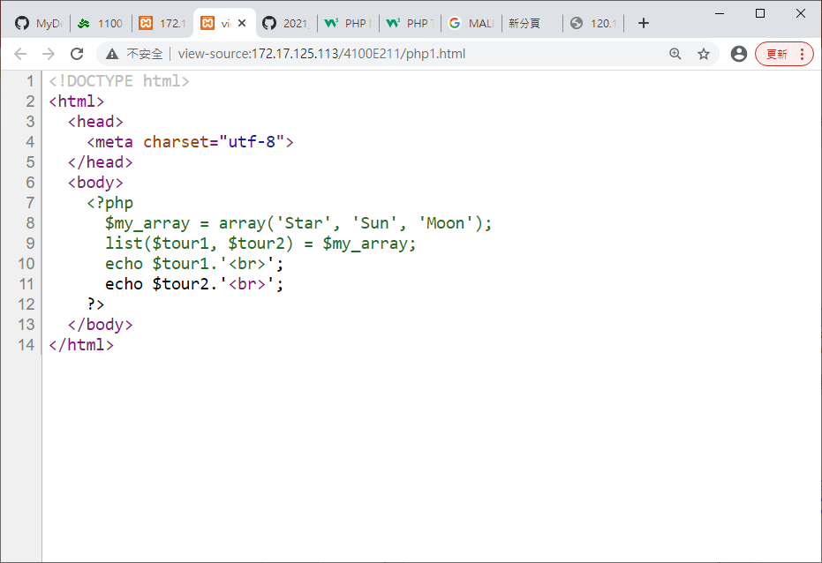
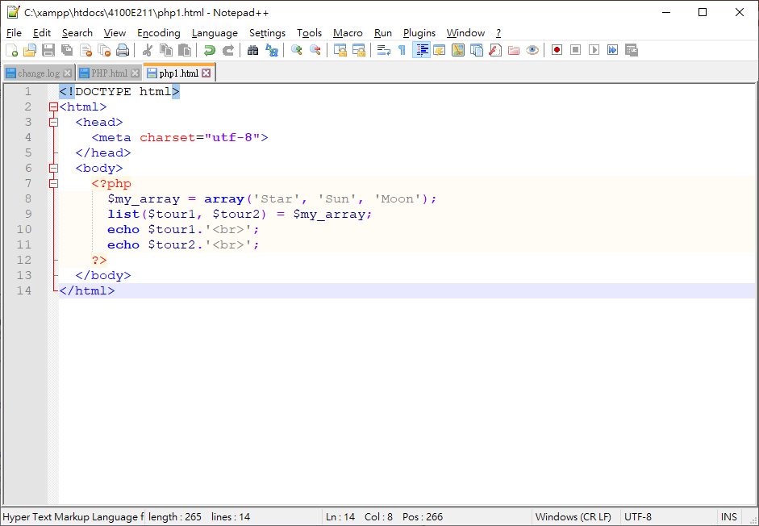
BROWSER
WHAT YOU SEE
ORIGINAL PHP PROGRAM
SERVER - SIDE PROGRAMMING

Slide 53
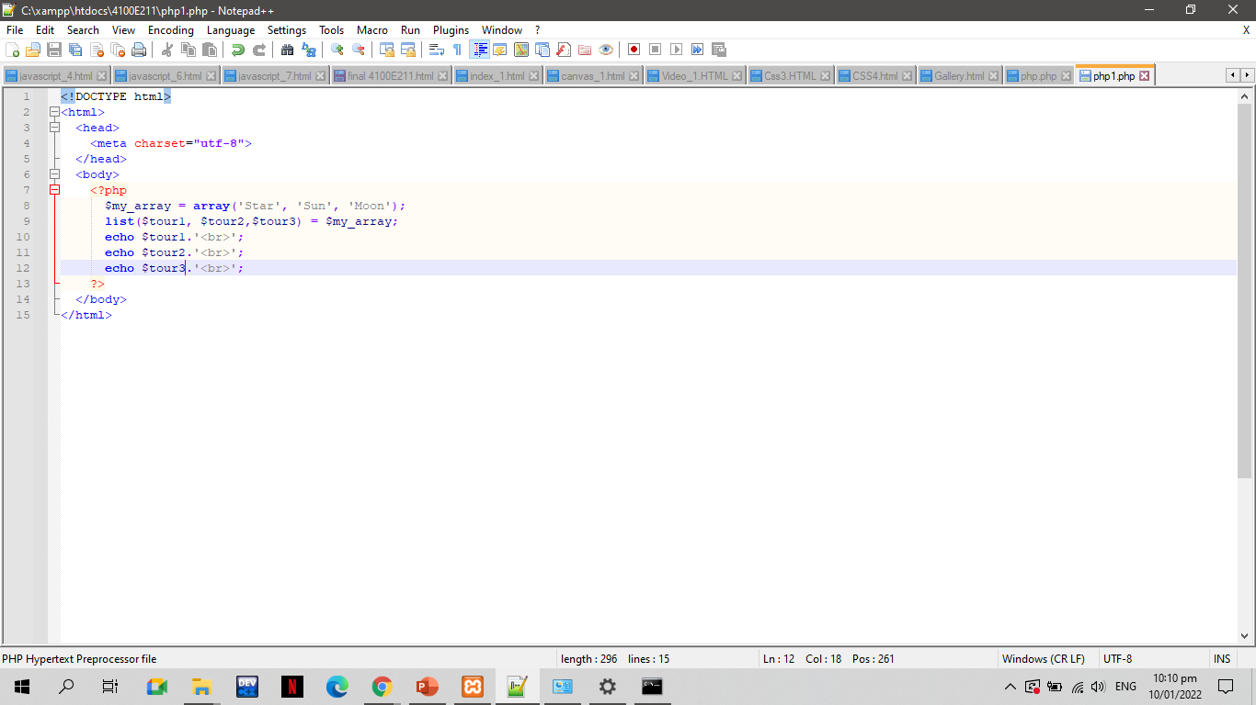
PHP1.PHP

Slide 54

Result

Slide 55

PHP2.PHP

Slide 56

Result

Slide 57

Function.php

Slide 58

Result

Slide 59

PHP.php

Slide 60

Result

Slide 61
Java Script

Slide 62



RESULT 1
Click the click me to show another result
RESULT 2
Javascript Codes

Slide 63



Result 1
Click next for the 2nd result
Result 2
Javascript codes

Slide 64


Codes
Result

Slide 65



Click the “show result” to see the next result
RESULT 1
RESULT 2
CODES

Slide 66



Click the print this page to show another result
RESULT 1
RESULT 2
CODES

Slide 67



Click the show time and date to show another result
RESULT 1
RESULT 2
CODES

Slide 68
My Funny Website

Slide 69

CODES

Slide 70


Slide 71


Slide 72


Slide 73

RESULT

Slide 74

Agenda
Unorder and order lists

Slide 75

REFERENCES
My HTML WORKS

Slide 76

My HTML WORKS

Slide 77

My CSS Works

Slide 78

My JavaScript Works

Slide 79

My PHP Program

